Slide 1
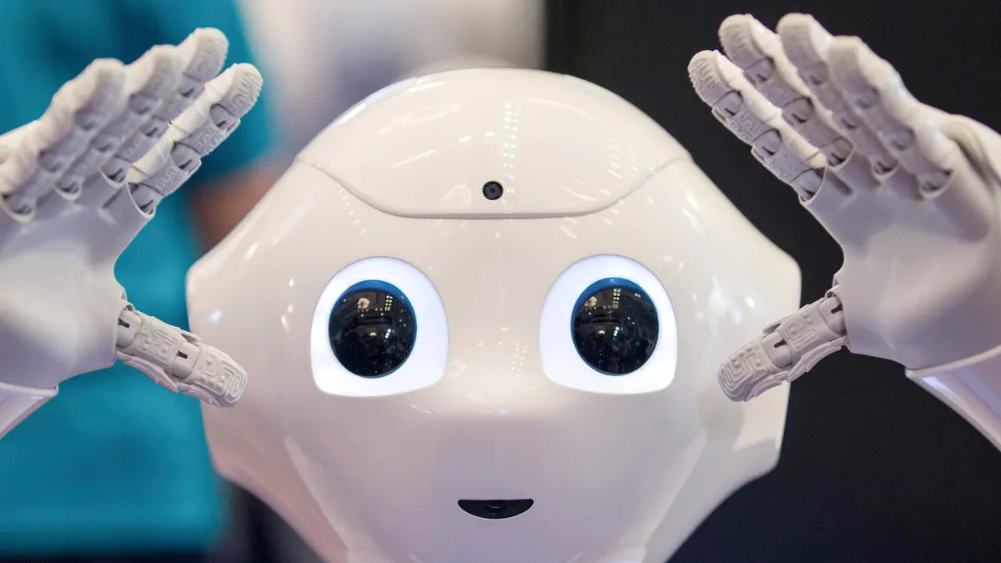
Image Registration Techniques
Shivam Pandey 17807671

Slide 2
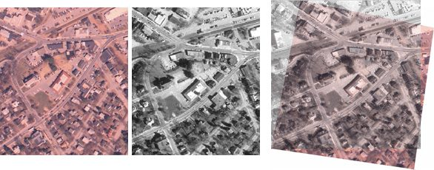
Image Registration
Image Registration is interpreted as the process of overlaying two or more images of the same scene with respect to a particular reference image.
The images may be taken in different circumstances, at different time lapse, with different viewpoint, or with different sensors.

Slide 3
Types of Image Registration
Multi-view Registration
Images of the similar object or scene are captured from multiple viewpoints.
Mosaicking of images
Shape recovery from the stereo.
3D-Reconstruction
Multi-temporal Registration
Images of the same object or scene are captured at various time points.
Motion tracking
Tracking the growth of tumors.
Multi-modal Registration
Images from different sensor sources
Images taken from Swarm Systems
MRI + CT

Slide 4
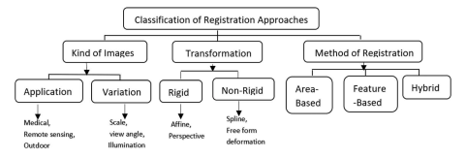
Classification of Image Registration Methods

Slide 5
Focus on Feature and DCNN based methods
Features are individual points at subpixel level accuracy with descriptor attached with them.
Area based methods are more Medical Science oriented as there are lesser features in the MRI images thus, we need depend on contours and area-based methods.
GIS and Remote Sensing have the data with sufficient texture to determine features and thus feature based methods are used in almost all the tasks like robotics perception, computer vision, GIS, 3D scene reconstruction, localization , and SLAM etc.

Slide 6
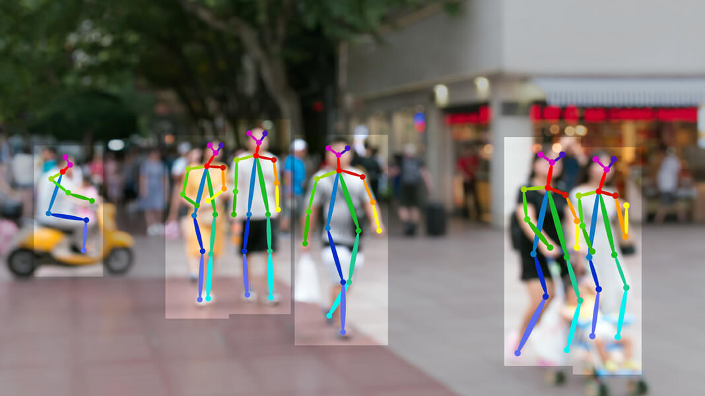
Image alignment Procedure
Feature Detection
Corner Detection
Other Interest point detection methods
Feature Matching
Kd-tree query
Transform model Estimation
Affine
Barrel or other distortions
Image transformation
Image resampling
Co-ordinate transform
Brute force methods
Distance measuring metric L1 / L2 or complex

Slide 7
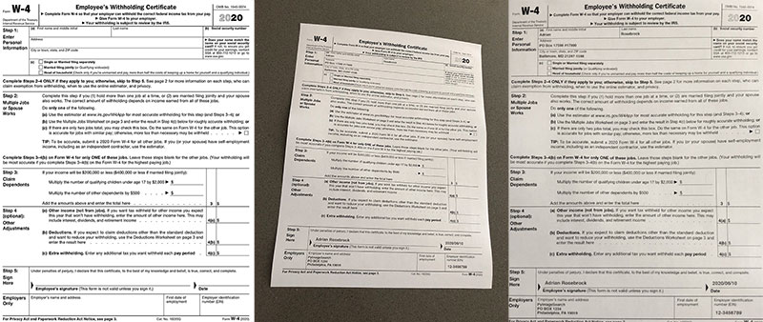
Target Image
Source Image
Aligned Image

Slide 8

Feature Detections
Manual
Manually marking of the interest points
May be erroneous and inconsistent
Automatic [Preferred]
Closed-Boundary regions
Edges and Contours
Line intersections
Corners with COG and Line endings

Slide 9

Popular Conventional Feature Detector and Descriptors
SIFT: Scale-Invariant Feature Transform
Doesn't depends on the scale of image
Uses DoG at multi-scale to determine local maxima as a feature point.
Neighborhood gradients are used as a descriptors (128-Dimension)
SURF: Speeded-Up Robust Features
Faster version of SIFT features
BRIEF: Binary Robust Independent Elementary Features
Uses sequence of 0 & 1 to define the feature descriptor
Descriptors are efficient in memory consumption
Faster in computation if compared to SIFT and SURF
Doesn't provide any default method for feature identification
ORB: Oriented FAST and Rotated BRIEF
Faster version of BRIEF

Slide 10
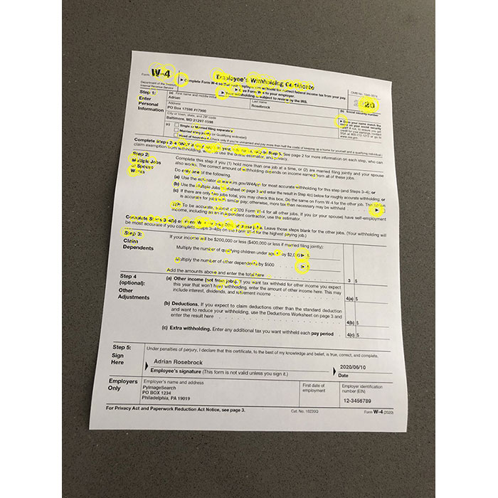

Slide 11
Correspondence Estimation
Use L1 or L2 norm on disparity of description vectors of source and target image to get correspondence according to some fixed threshold.
Hamming distance is used for the BRIEF descriptors as they are continuous sequence of 0 or 1, L1 and L2 norm can't work on them.
Similarly, the SIFT, FAST, and SURF etc. Float based descriptor can't use Hamming distances, thus only continuous discriminator is allowed.

Slide 12
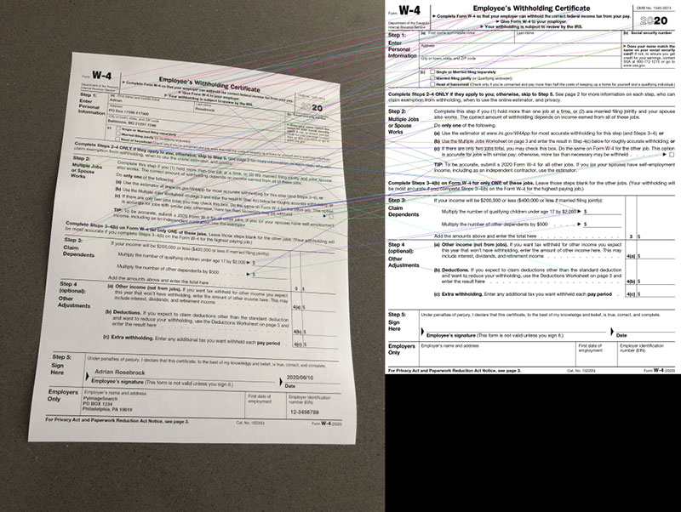

Slide 13
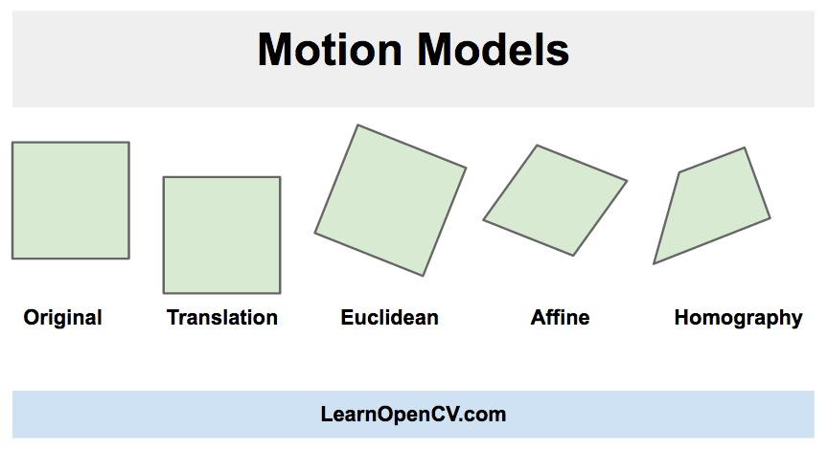
Transformation Model Estimation
Also known as motion model of images.
Rigid Transformation
Translation, Rotation, or Linear combination of Dimensions
Affine
Perspective
Non-Rigid Transform
Utilizes non-linear functions
Able to model Image Distortions (Barrel Distortion etc.)
Spline

Slide 14
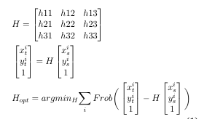
Optimization to Get Transformation Parameters
Using some optimization technique to determine H
Generally used SVD, with RANSAC
As the problem grows in non-linea domain, quadratic optimization algorithms like Lavenberg-Marquardt, Gauss Newton etc. Could be used.
Especially when the correspondences are continuously changing with the iterations.

Slide 15
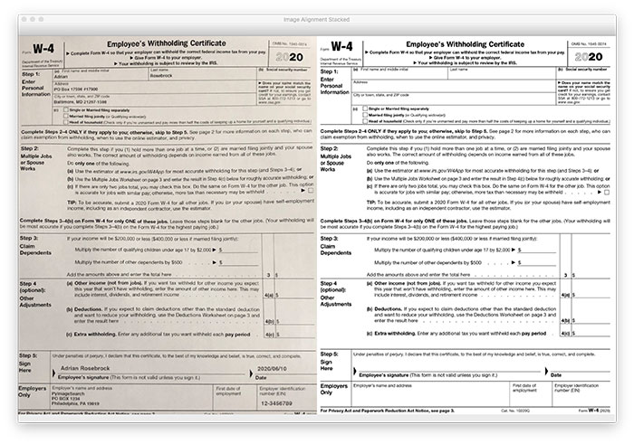

Slide 16
Source Image Transformation
Once the transformation parameters are determined.
The Source Image is transformed on the same canvas width as that of target Image.
After the transformation, the pixels won't match correctly, thus some kind of interpolation and re-sampling is needed to fill out the new canvas, to represent source image in co-ordinate system of target image.

Slide 17
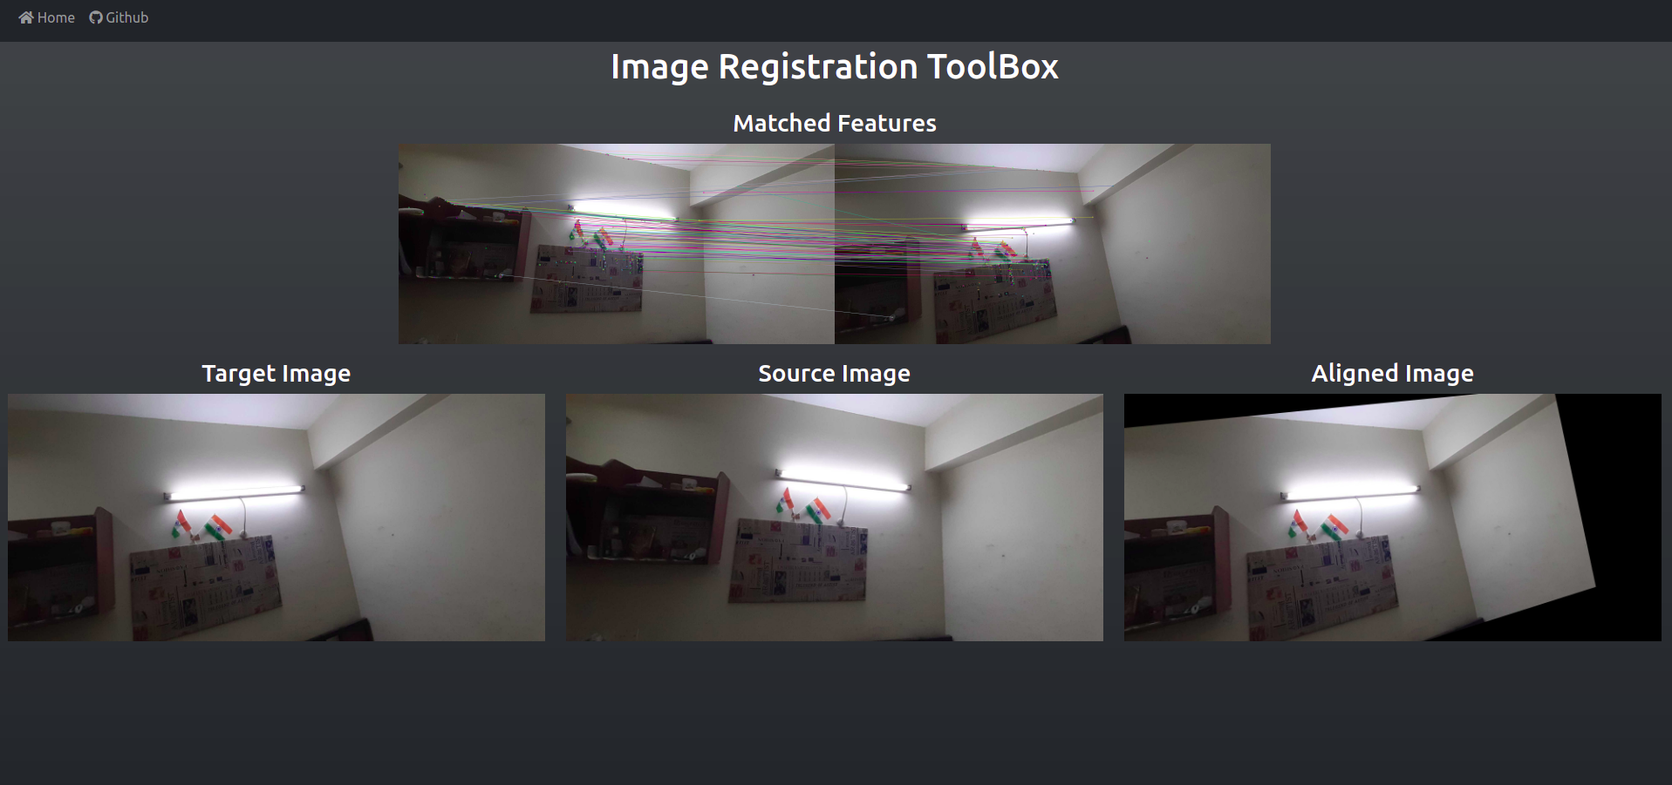

Slide 18
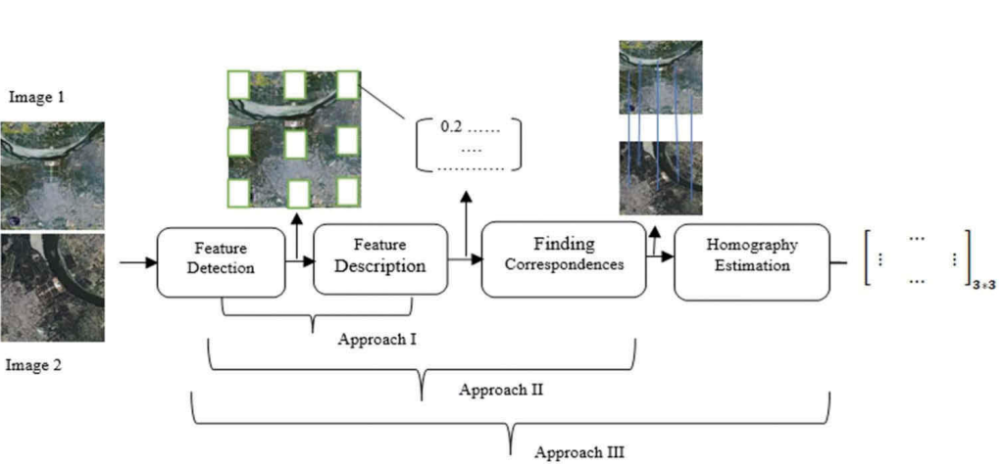
Deep Learning Based Approach

Slide 19
Interest point Detection and Descriptors with DNN
Conventional feature descriptor are designed specific to scenario.
Doesn't generalizes well in harsh light conditions, or motion blur type of distortions.

Slide 20
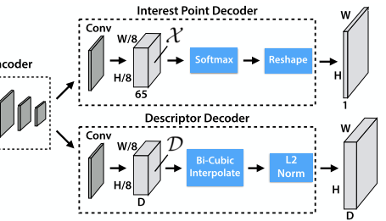
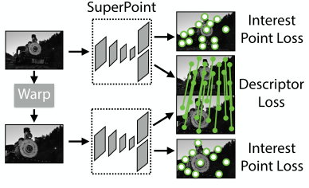
SuperPoint DCNN for Interest Points
Uses a Unified Encoder Network
Separates out the Decoder/Upsampling nets to reduce computation cost.
The cost function is defined by the synthetic homography transform and reversal after prediction, then matching both the results.

Slide 21
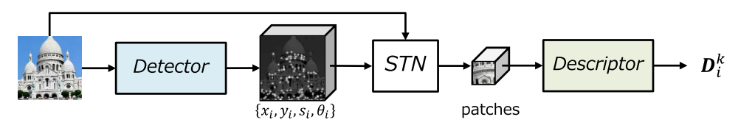
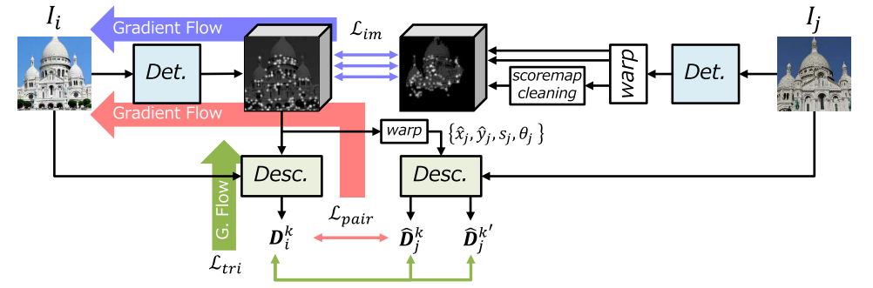
LF-Net: Learning Local Features from Images

Slide 22
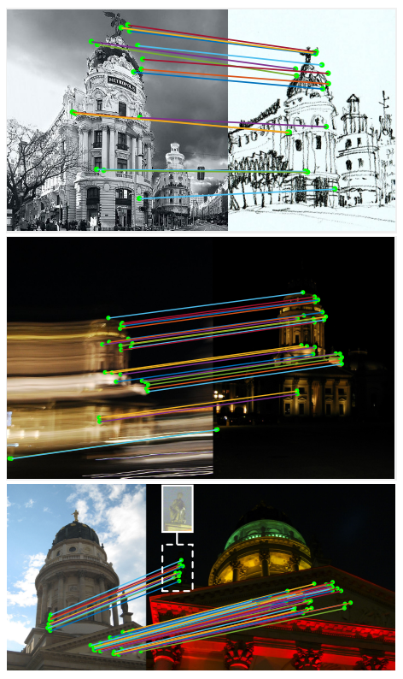
Expected from DCNN based Feature Extraction
Robust towards environment change.
Lower the effect of motion blur.
More distinguishable feature vectors.

Slide 23
Approach2: Finding Correspondences
Due to representation of feature vectors in other dimension(Effect of added layers) the simple L1 & L2 norms are no more effective.
DCNN based relation b/w descriptors can provide more precise and accurate correspondences.

Slide 24
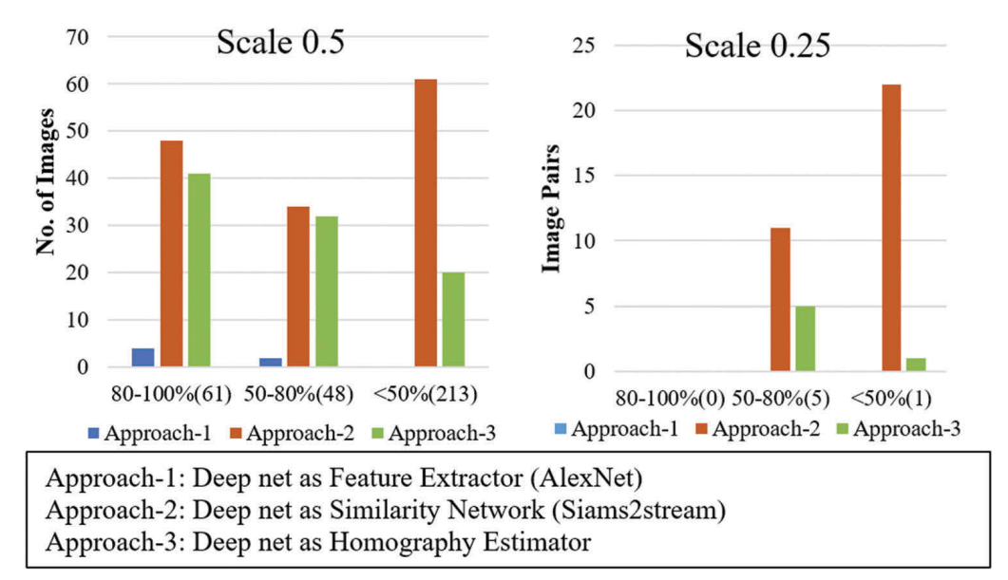
Approach3: End-To-End Homography Estimation
Possible with DCNN, but in some results it has shown suppressed performance.
Kavitha Kuppala et al.

Slide 25
ImageRegistration-ToolBox
Demo for Conventional Feature-based Image Registration methods

Slide 26
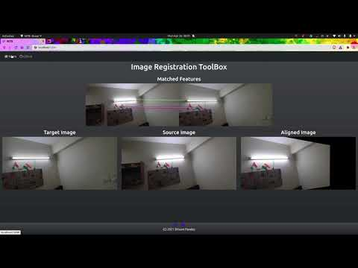

Slide 27
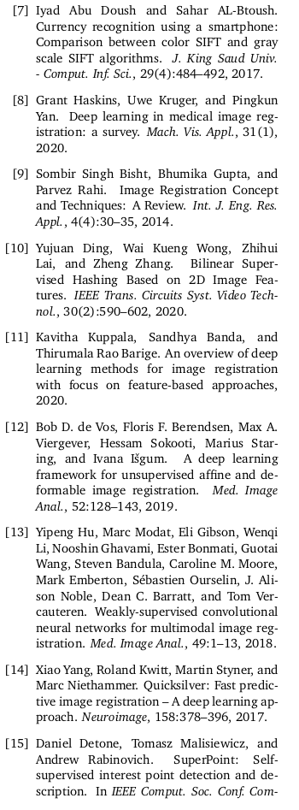
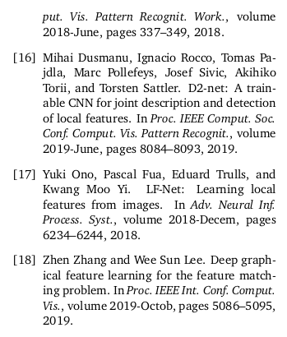
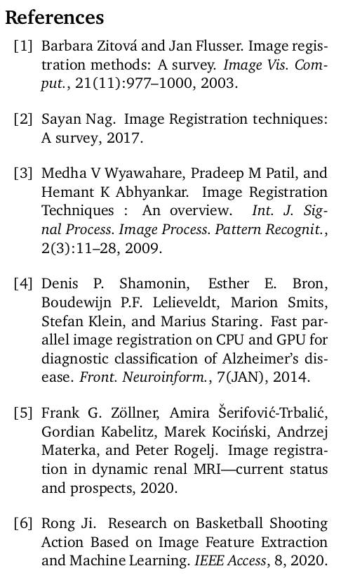
References

Slide 28
Thank You
Image Registration Techniques

